Slide 1
STEPS IN COURSEWARE/WEBSITE/
MOBILE APPS
DEVELOPMENT
EDU 711

Slide 2
Steps to Courseware/Website/Apps Development
1. Plan & Set Up
2. Storyboard
5. Quality Control
3. Graphics
4. Author Course

Slide 3
Step 1 : Plan and Set Up
Analyze, design your lesson
Obtain all course content in electronic form
Establish roles and responsibilities (tasks)
Set project schedule
Create design guide - flowchart
Create templates – Storyboard
Determine course navigation, structure, numbering – Storyboard
Create folders

Slide 4
Roles & Responsibilties
Project Manager
Manages process, sets scedhule and ensures that everyone follows it
Instructional Designer
Writes storyboards, breaks content into manageable chunks. Writes objectives. Designs interactions and writes test questions
Graphic Designer
Finds or creates graphics ISD specificies. Sizes and optimizes for web
Delivery.
Quality Control
Reviews course. Identifies and records all problems.
Web Page Developer
Turns storyboard into web pages. Cuts and pastes the text, inserts the graphics,
creates interactions. Also creates templates before course development begins.

Slide 5
Set Schedule
Week 1 | Week 2 | Week 3 | Week 4
Write design guide. Create templates. | Storyboard lsn. 1 | Storyboard lsn. 2 | Storyboard lsn 3
 |  | Graphics & Author lsn 1 | Graphics & Author lsn 2
 |  |  | Quality Control lsn 1

Slide 6
Design Guide
This document will specify items such as
Page tile font
Size and type of content font
Style used for links (to display links or references)
Color scheme

Slide 7
Course Structure
Course Summary
Course Intro
Course Menu
Content
Lesson 1 Intro
Content
Content
Lesson 2 Intro
Review
Questions
Lesson 3 Intro
Summary
Lesson 4 Intro

Slide 8
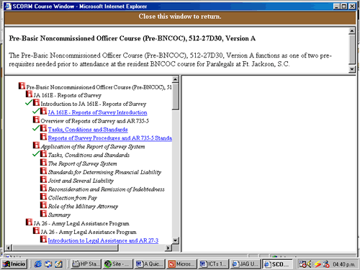
Course Structure: Menu/Index

Slide 9
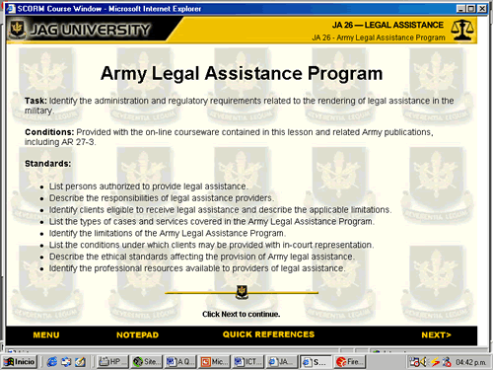
Course Structure: Introduction

Slide 10
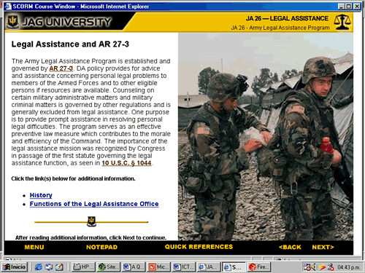
Course Structure: Content (layers)

Slide 11
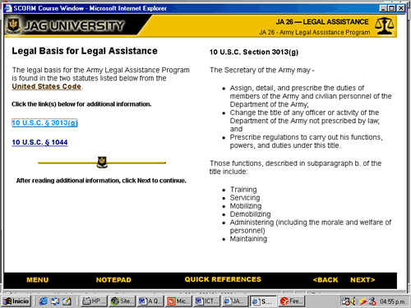
Content Structure: Layer Reveal

Slide 12
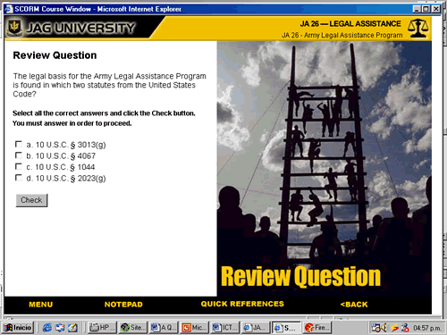
Review Question: MultipleChoice

Slide 13
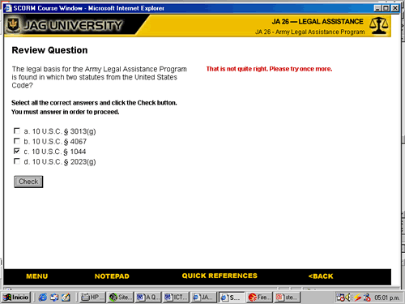
Incorrect Feedback

Slide 14
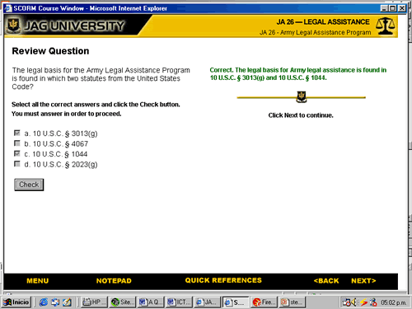
Correct Feedback

Slide 15
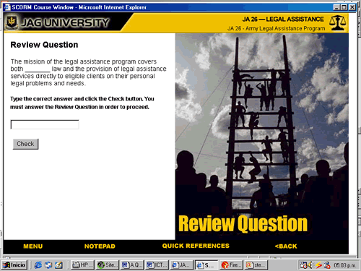
Fill in the Blank

Slide 16
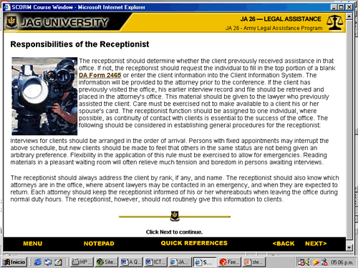
Full Page

Slide 17
Page Structure
What are the main parts of every courseware page?
Title
Content
Navigation

Slide 18
Navigation
How do students access first page of lesson?
(From Course Menu)
Next / Back arrows usually displayed. May sometimes want
to hide Next arrow, to force a student to answer a question for
example
Other Navigation needed? To Course Menu. To Resources.
What happens when a student finishes a lesson? Goes straight to
begining of next lesson, or back to main menu?

Slide 19
Templates
What to include?
Title bar: UNIVOnet, Course Name, Lesson Name
Navigation bar: Link to Course Menu, References,
Back Button, Next Button.
Image: Some pages, such as Lesson Intro and Review
Questions, may use a common graphic. Content Pages will
have unique images.
Type of Template: What are all the different types of pages
in the course?

Slide 20
tion (multiple choice)
Review Question
Blah blah blah blee. which of the following are correct?
SSSSSccccc
Sdsdsfgdd
Dfdfdfdfdf
Review Question
Graphic

Slide 21
Page Numbering
wd01_0020
wd01_0030
wd01_0040
wd = course title
01 = lesson number
_0020 = page number

Slide 22
Folder Set Up
Need to create the folders in which to place all
Files related to the course.
Where to put storyboards and design documents?
One folder for each lesson, or one for whole course?
Suggest two image folders: original and web ready.
Suggest two site folders: production and final.

Slide 23
Storyboard
Once the set up is complete, the templates created,
the design guide written, the folders set up, etc, the course
can be stroyboarded.
Ideally the storyboard will stand on its own, will contain
everything the graphic designer and the web developer
need to create the web pages.

